Slide 1
Model-based Integrated Planning and Control of Autonomous Vehicles using Artificial Potential Fields with uncertain environment
Emilio Benenati
Josyula Viswanath Das
4th February 2022

Slide 2
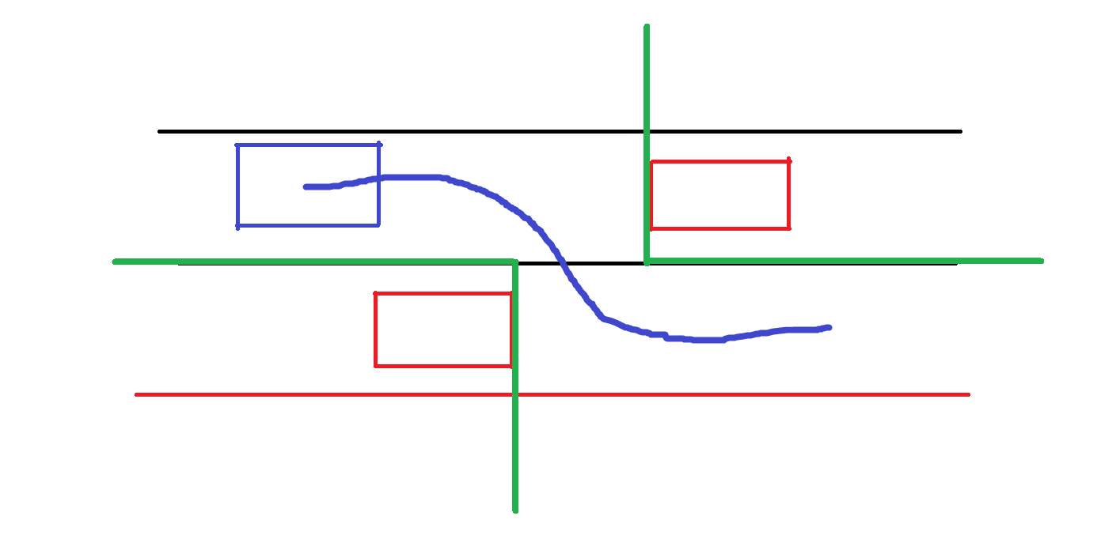

Slide 3
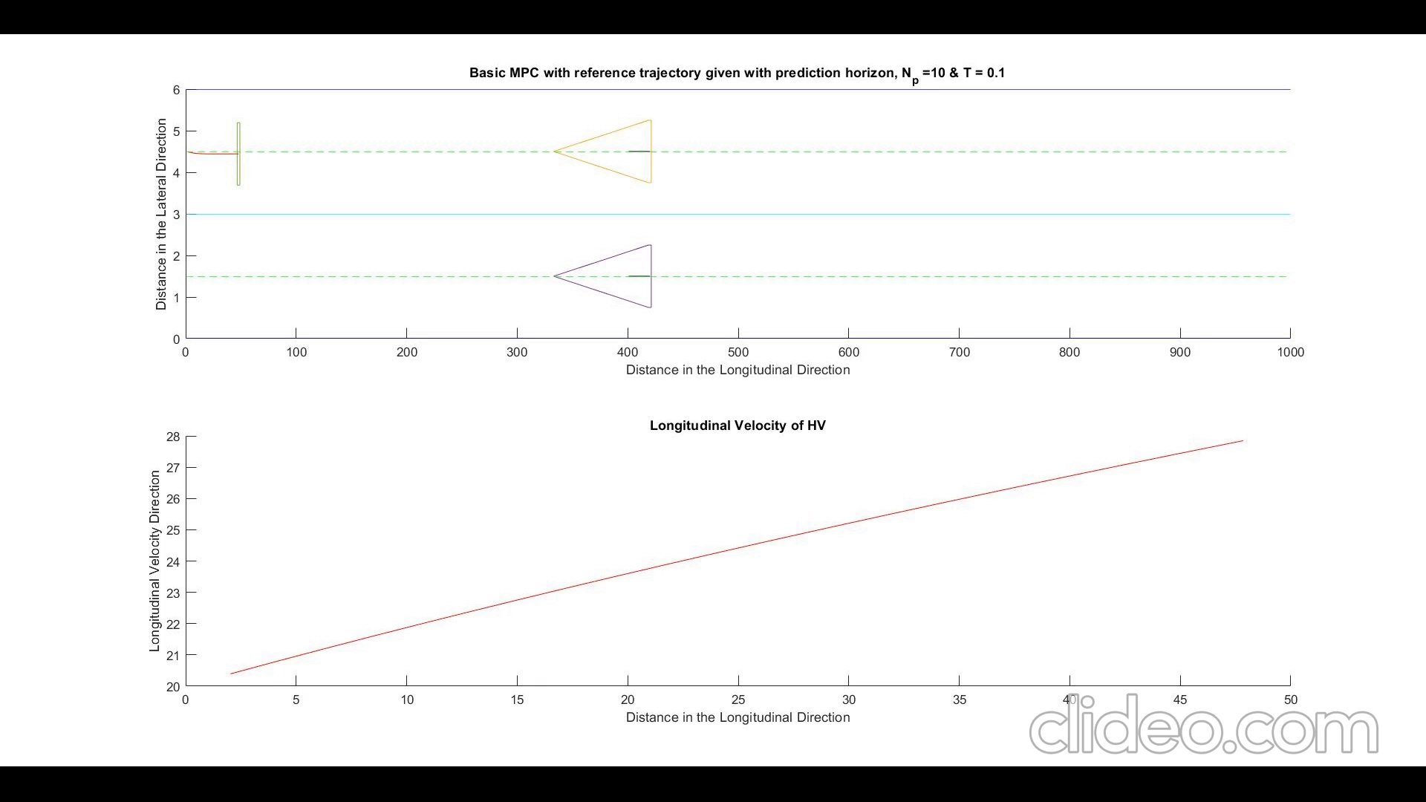

Slide 4
Two problem with the above part
How do I define the green areas as I have to define a set including all the x,y coordinates of the system. If I have to represent it as (x>x_thres && y<y_threshold), I wanted to ask if this is possible as a constraint because I could not think of a way to add this.
Problem 2- Problem with lane change when the host vehicle cannot change lanes due to the presence of an obstacle in the next lane,

